Slide 1
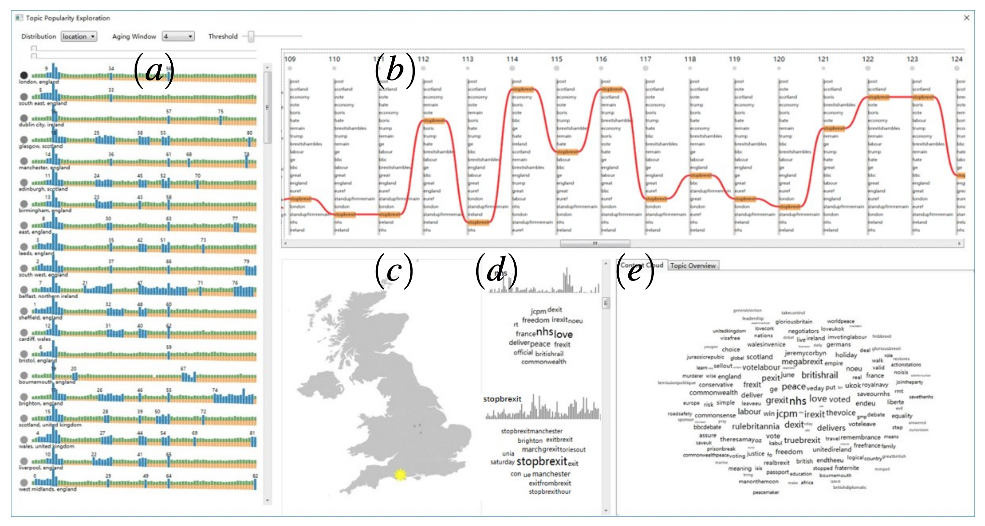
Collection of tweets related to Brexit
Jie Li, Siming Chen, Gennady Andrienko, and Natalia Andrienko. Visual Exploration of Spatial and Temporal Variations of Tweet Topic Popularity. Proceedings of the EuroVis Workshop on Visual Analytics (EuroVA), pp. 7-11, 2018. https://doi.org/10.2312/eurova.20181105

Slide 2
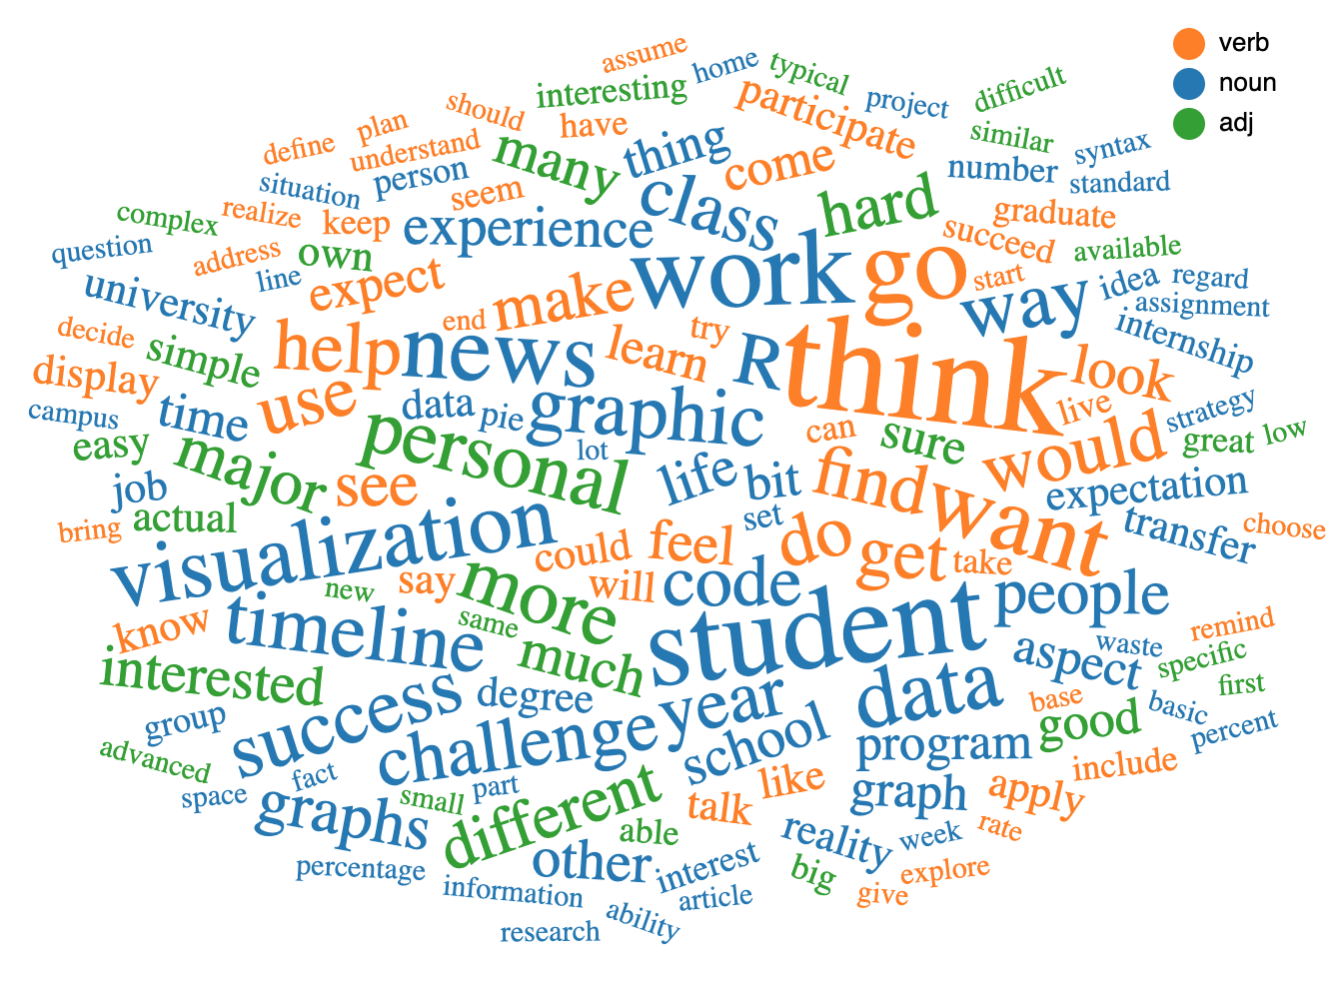
Student #1
Student #2
Student #3
… #n
R
purpose
data visualization
great program
code
tangible way
anything
challenges
two visualizations
personal timeline
news graphic
exercises
really hard time
news article
expectation
assignment
life
meaningful way
strategy
lack
prior journal
understanding
programs
data visualization
primarily exell
tableau
interface
graphs
screen
'codes
data sets
appearance
studior
javascript
actual 'coding' bit
python
track
code
complicated territory
visualization
java
bit
c++
teaching style
r
fact
pace
swirl
actual person
personal timeline
people
basics
year
major things
life
data visualization
news graphic
typical graphs
date
samuel

